Slide 1



Denver Dev Day
October 19th, 2018
Thanks to our sponsors!

Slide 2


Intro to Entity Framework Core
Data Access with C# and SQL Server
Matt Dixon
Managing Director/Founder
Front Range Systems

Slide 3

Overview
In this session you will learn
Why .Net Core
Why ORM
Getting Started
CRUD
Performance Tips
Raw SQL and Stored Procedures
Transactions
Notes:
Test notes

Slide 4
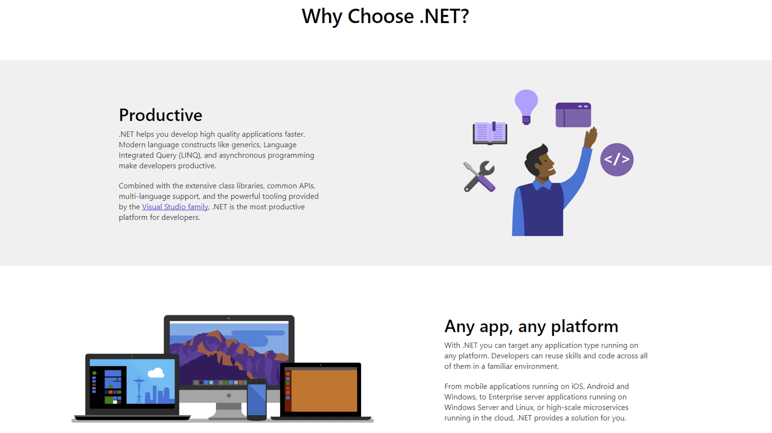

Slide 5
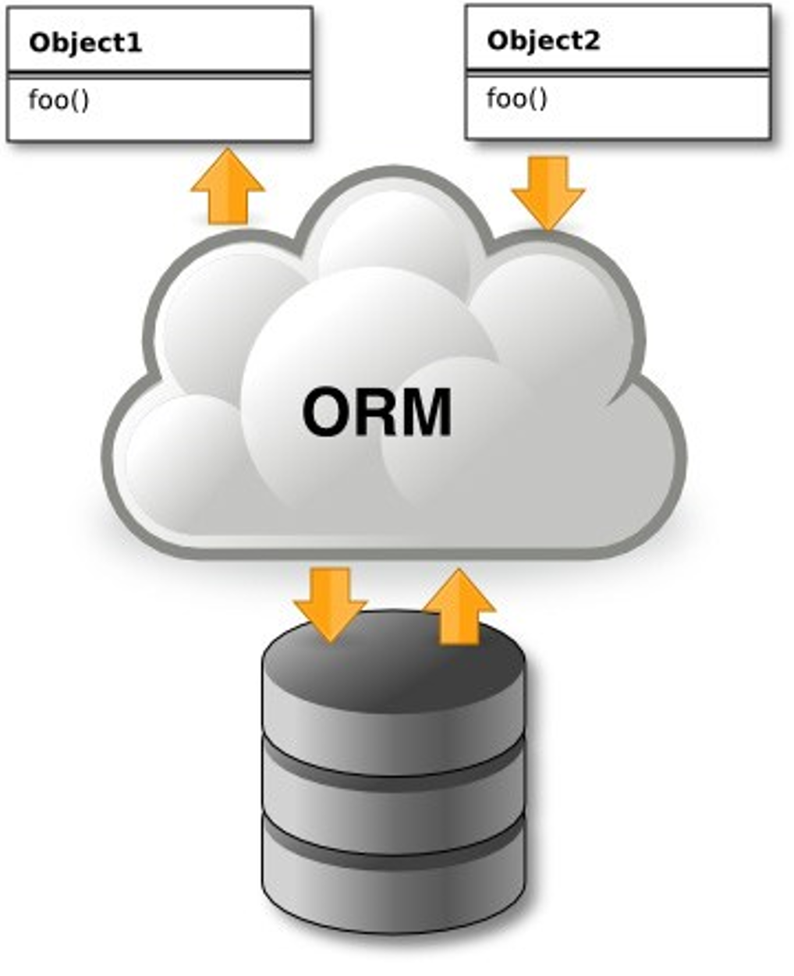
Why ORM
Turns relational data into objects
No inline SQL Statements
Pure Magic
Notes:
Test notes

Slide 6
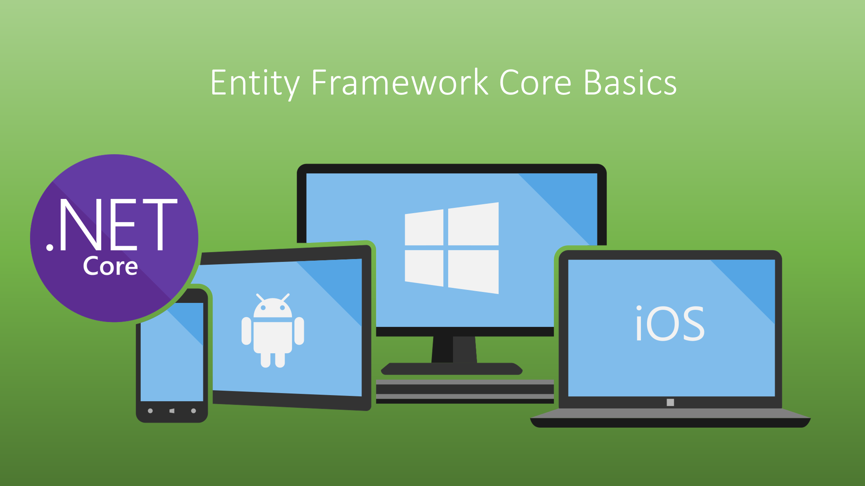
Notes:
Test notes

Slide 7
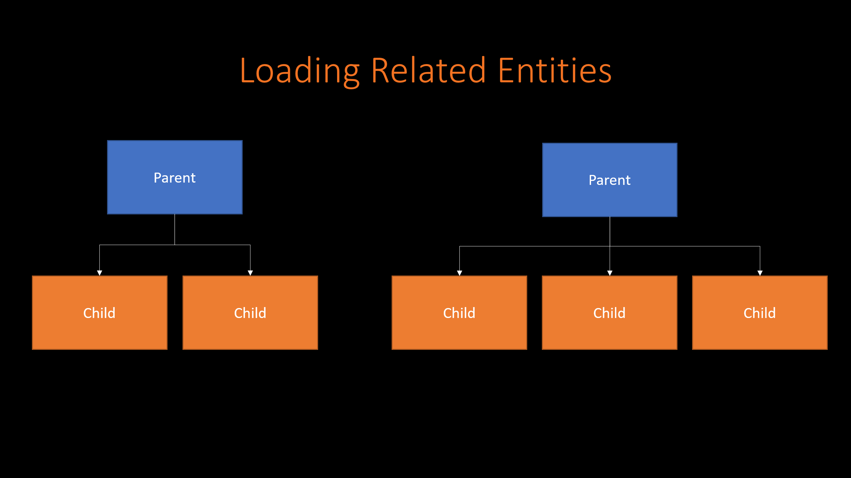
Notes:
Test notes

Slide 8

Notes:
Test notes

Slide 9
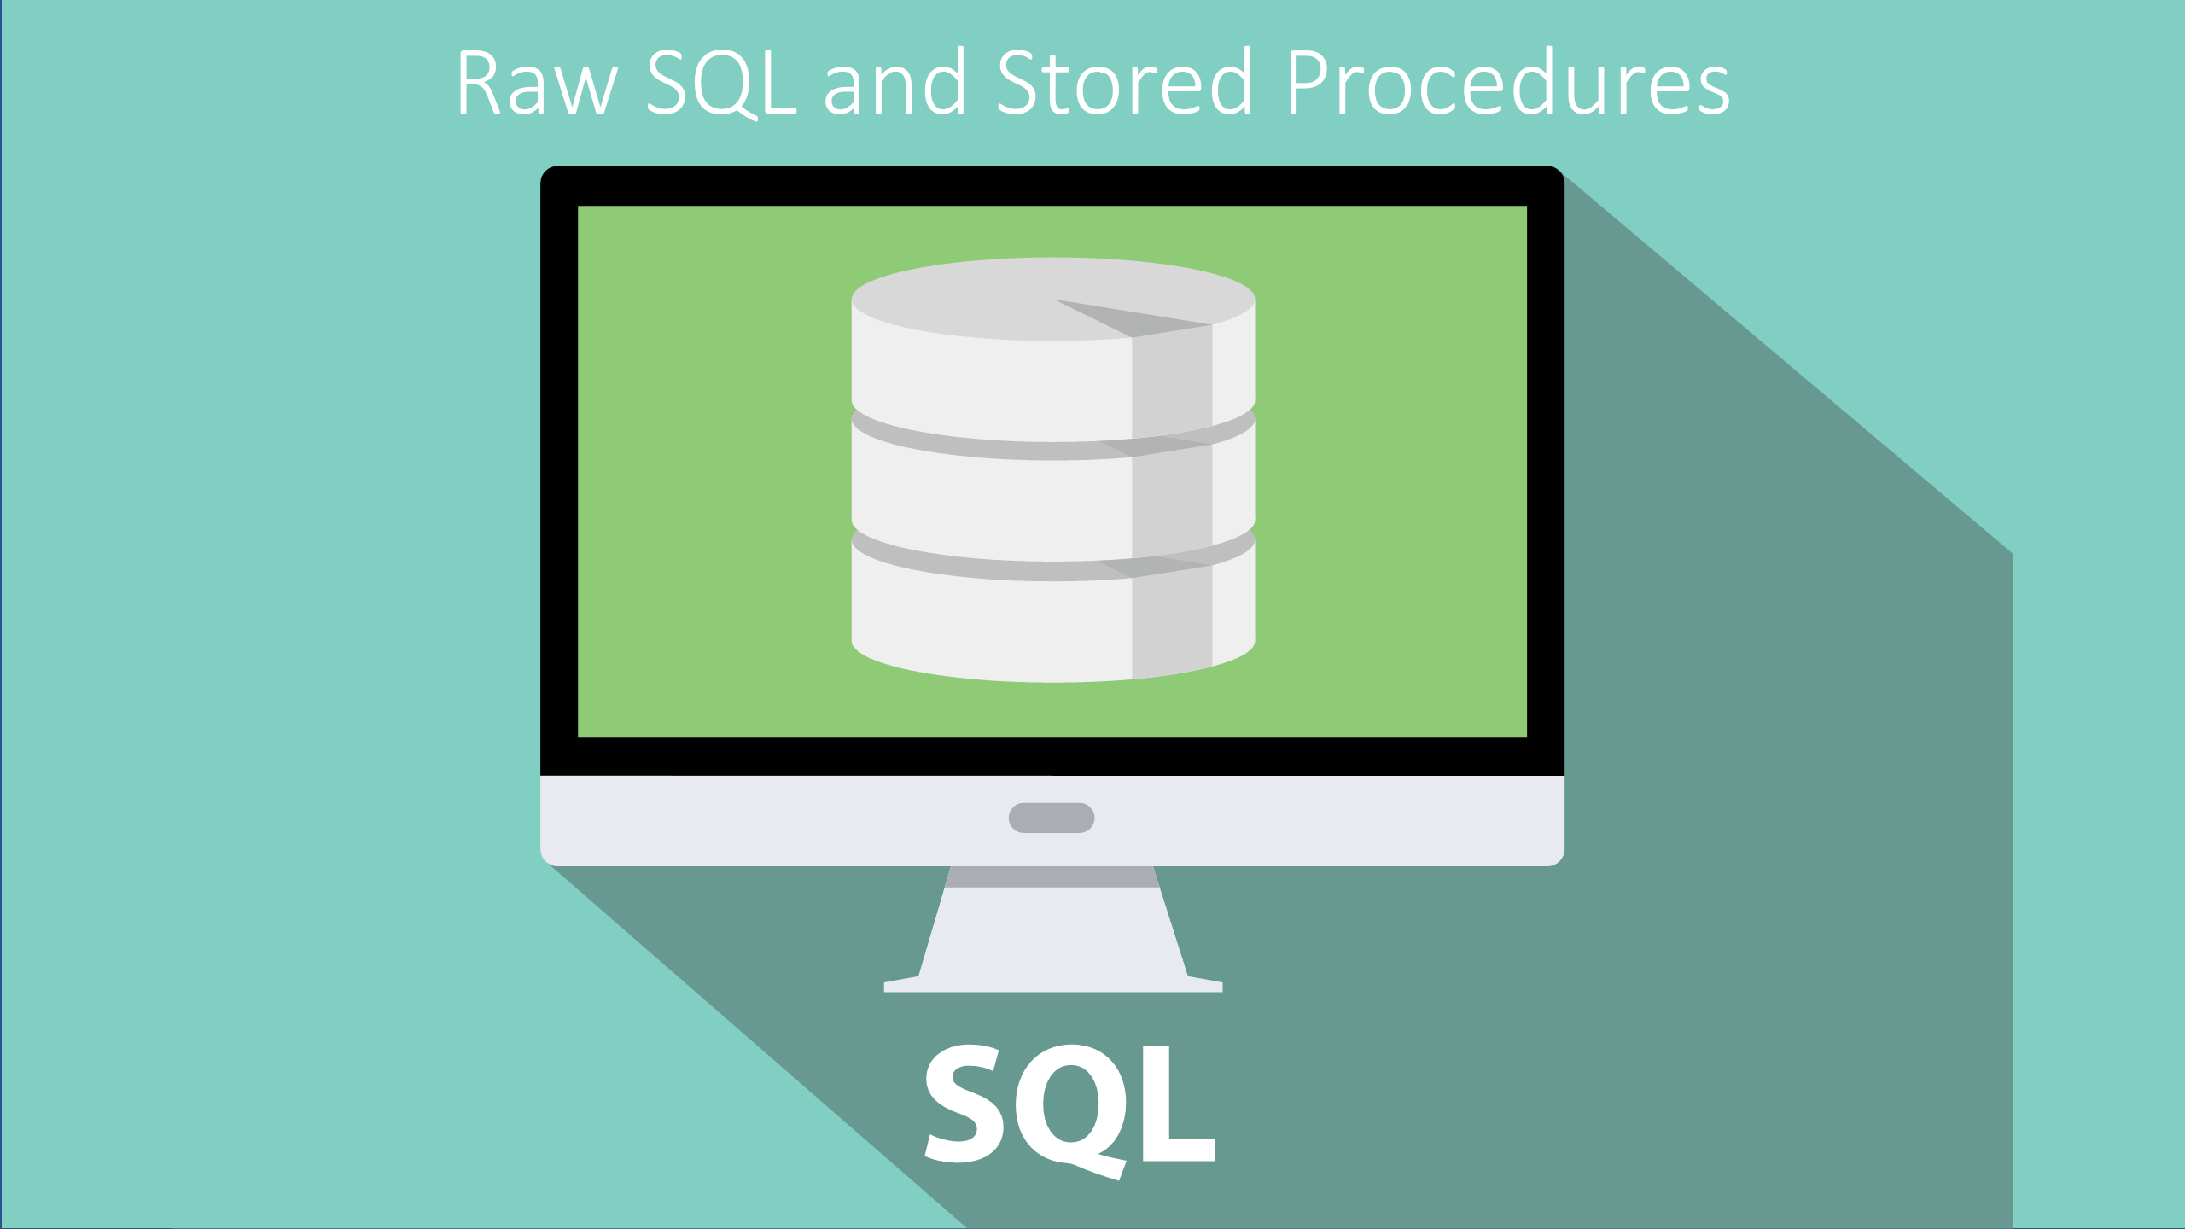
Notes:
Test notes

Slide 10

Notes:
Test notes

Slide 11
http://bit.ly/frs-introEfCore
Notes:
Test notes

